Slide 1

SPORTS INJURY MANAGEMENT SYSTEM
Group No.1:
Abisha Vadukoot
Ayush Fulsundar
Manvith Reddy
Ranveer Rajput
DAMG6210 Project
Under the guidance of Prof. M. Montrond

Slide 2
ABOUT:
The Sports Injury Management System (SIMS) is a comprehensive, centralized database designed to track and manage athletes' health, injuries, and recovery progress within a sports organization. The system aims to streamline the collection of medical records, improve communication among coaches, medical staff, and athletes, and ensure that recovery decisions are based on accurate, up-to-date data.
KEY FEATURES:
Centralized Injury Tracking – All injury records stored in one place for easy access.
Clearance Management – Track treatment progress and ensure medical clearances before return.
Real-Time Updates – Get instant reports on athlete health and recovery status.
Secure Access – Only authorized personnel can access sensitive data, ensuring privacy.
Analytics & Reporting – Generate custom reports on injury trends, treatment efficiency, and recovery timelines

Slide 3
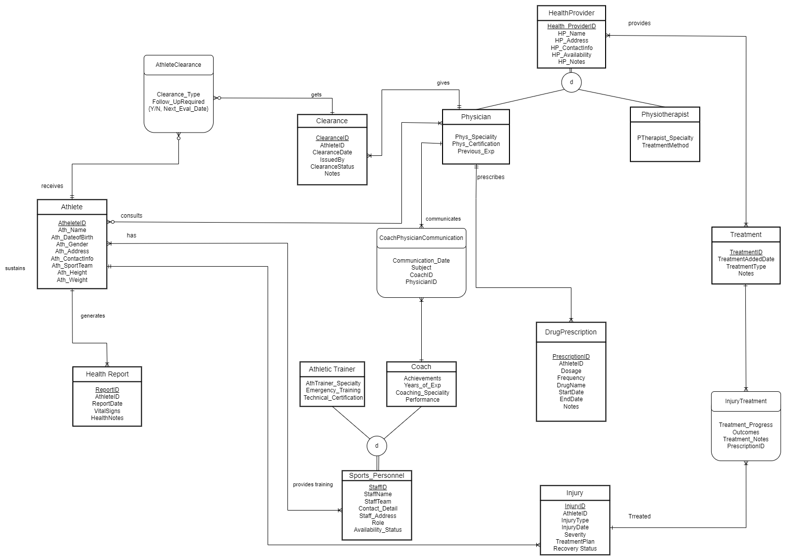
ERD Diagram

Slide 4
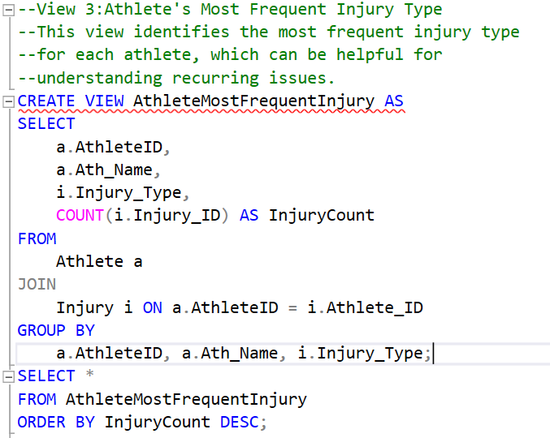
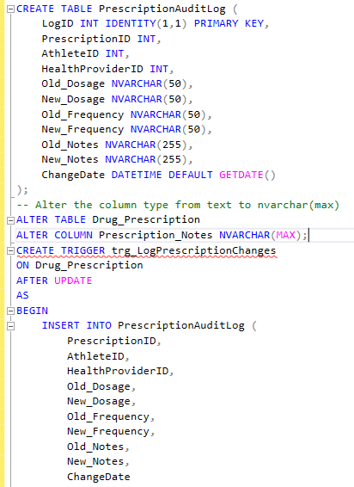
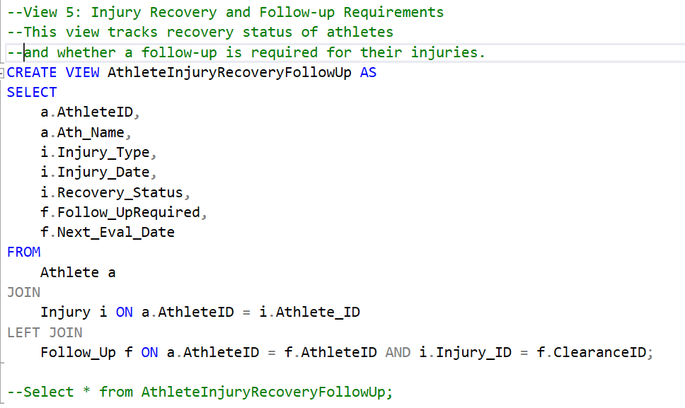
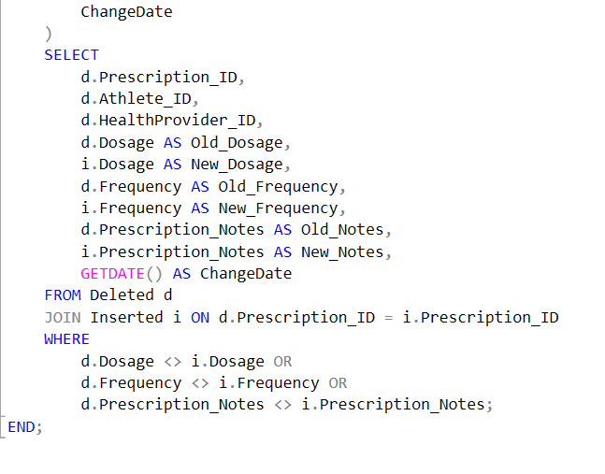
Views
Triggers

Slide 5
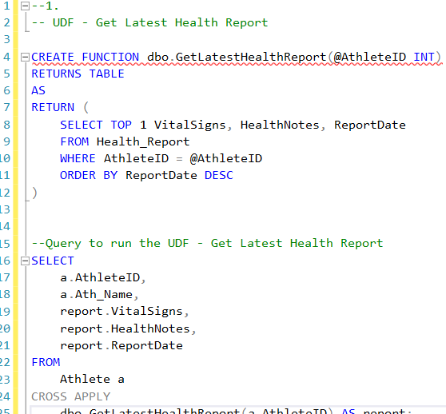
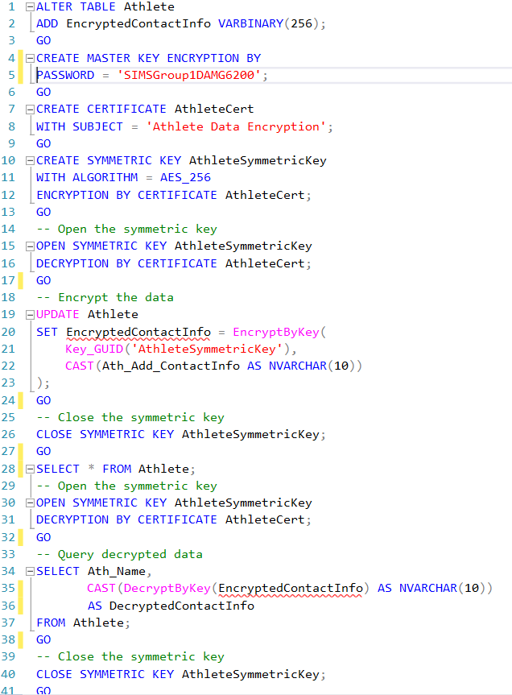
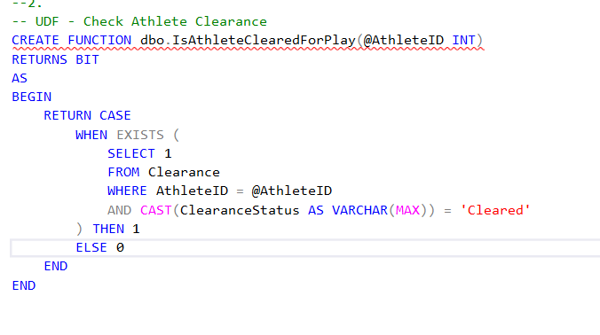
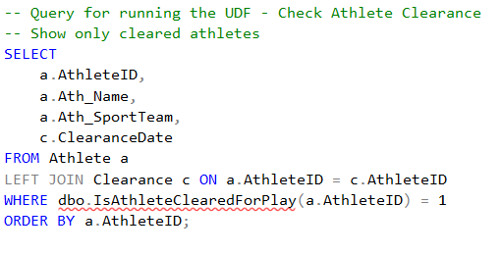
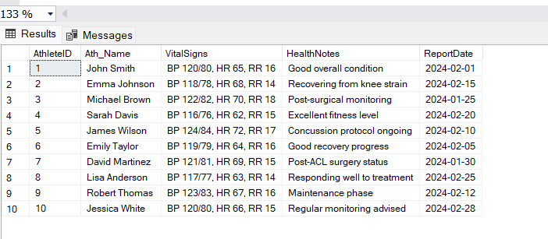
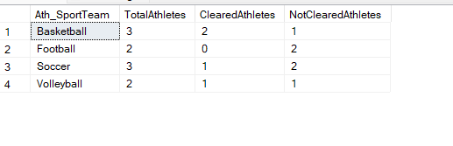
Encryption
User Defined Function
Show only cleared athletes
Show non cleared athletes
More detailed view for clearance

Slide 6
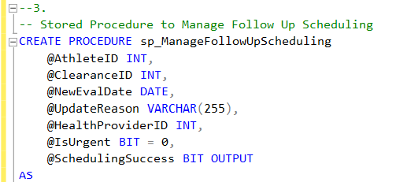
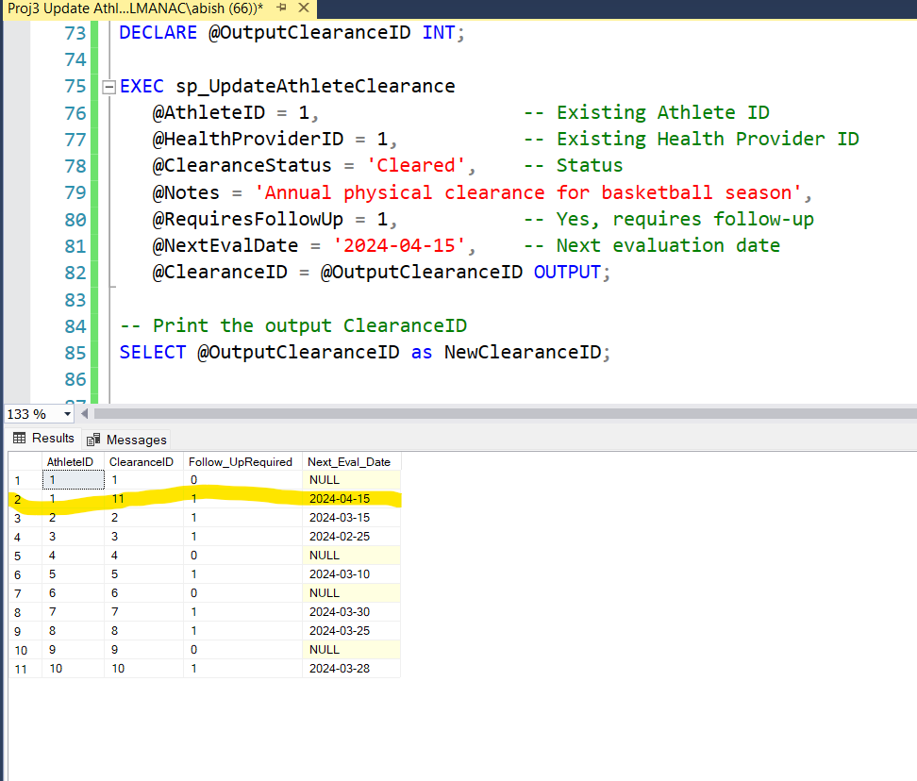
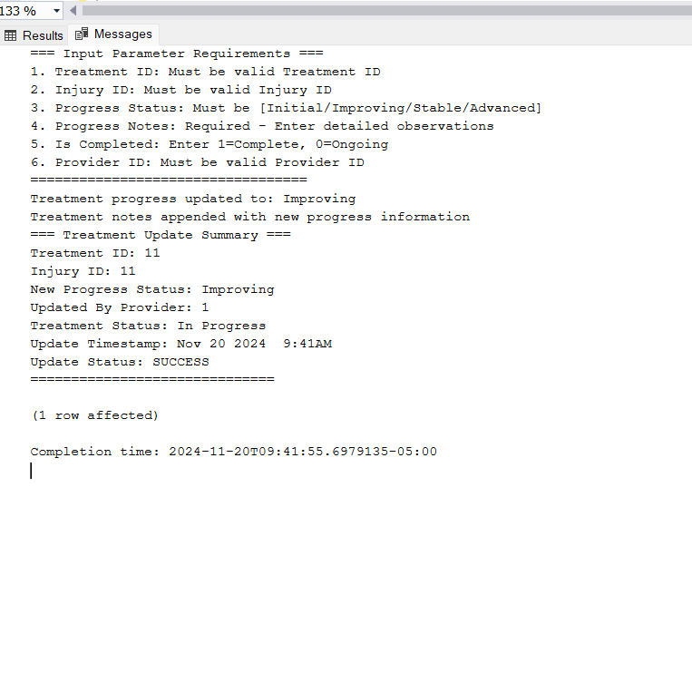
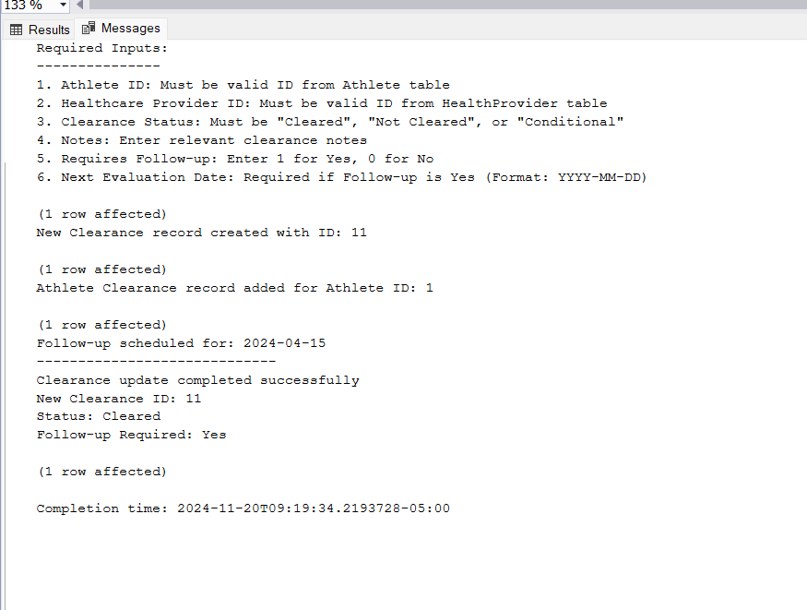
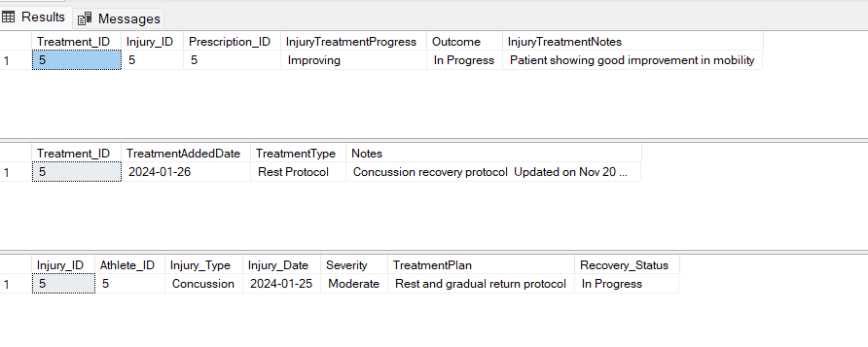
Stored Procedures

Slide 7
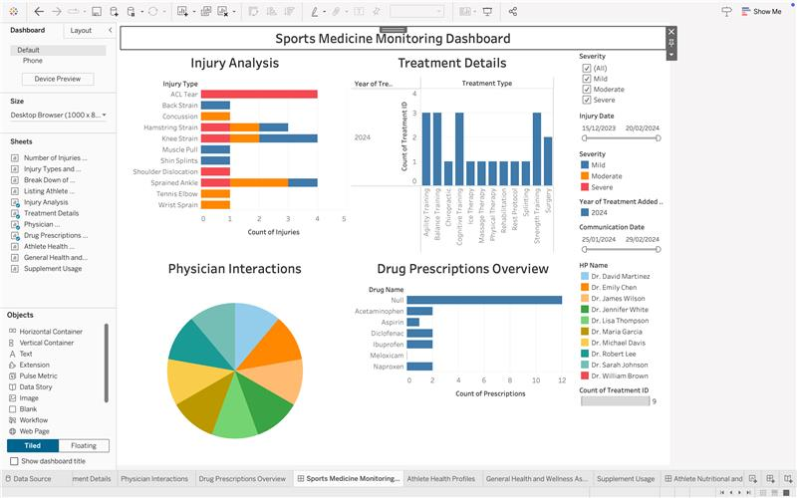
Tableau Report

Slide 8
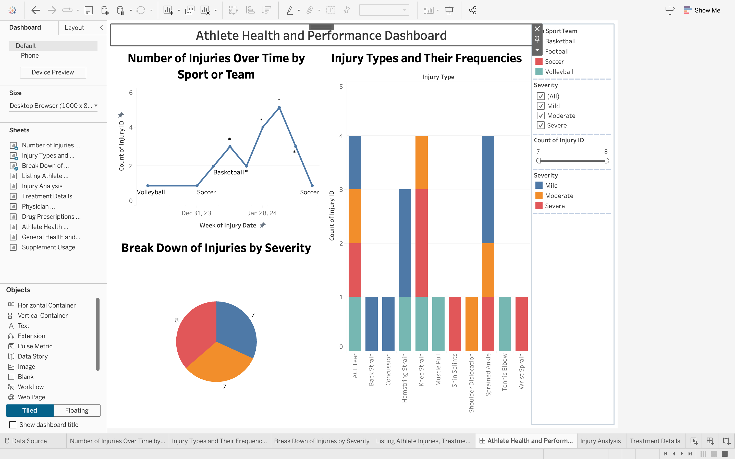
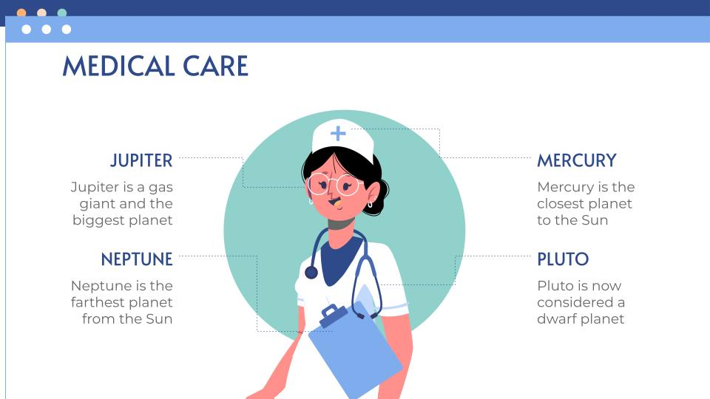
Tableau Report (continued)
Thank you!

